Slide 1

8-bit synth
Xilai Fan
Ruoyao Shi
Qianhui Sun
Yang Pan

Slide 2
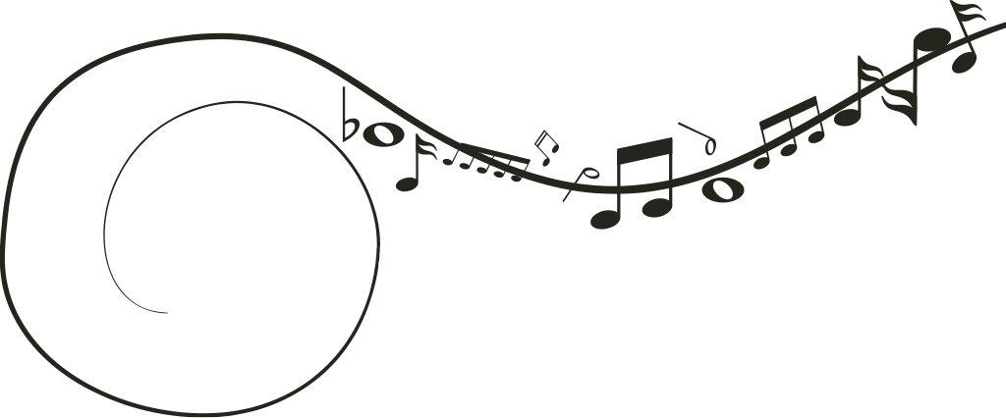
Catalogue
1
Introduction
4
Implementation
2
Problem Statement
5
Test
3
Design & Analysis
6
Division

Slide 3






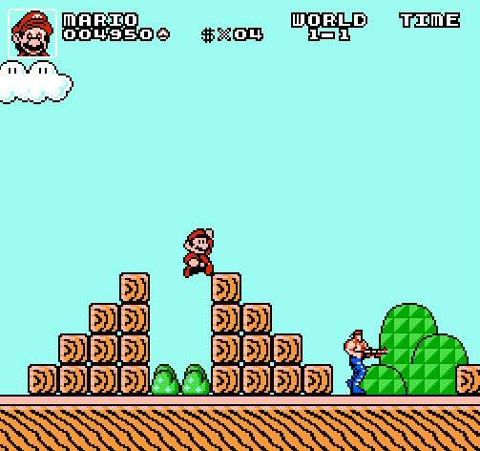

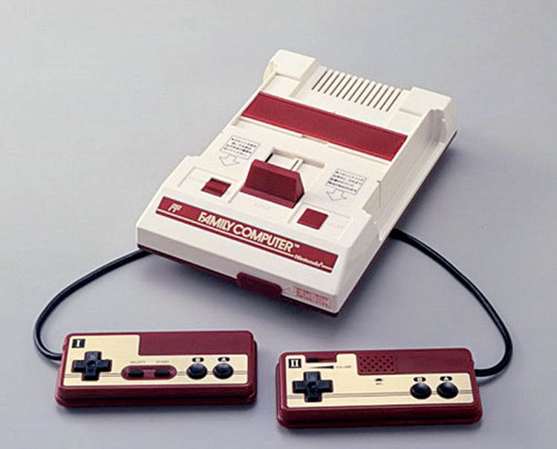

8 Bit Synth
Introduction
思考
FC

Slide 4



8 Bit Synth
Problem Statement
思考
User’s Input
t^2
(t*((t>9|t>13)&15))&128
t*t>11|t>9
9000&6000%t
(t/32)<5
Sound

Slide 5
8 Bit Synth
思考
Analysis
&
Design

Slide 6
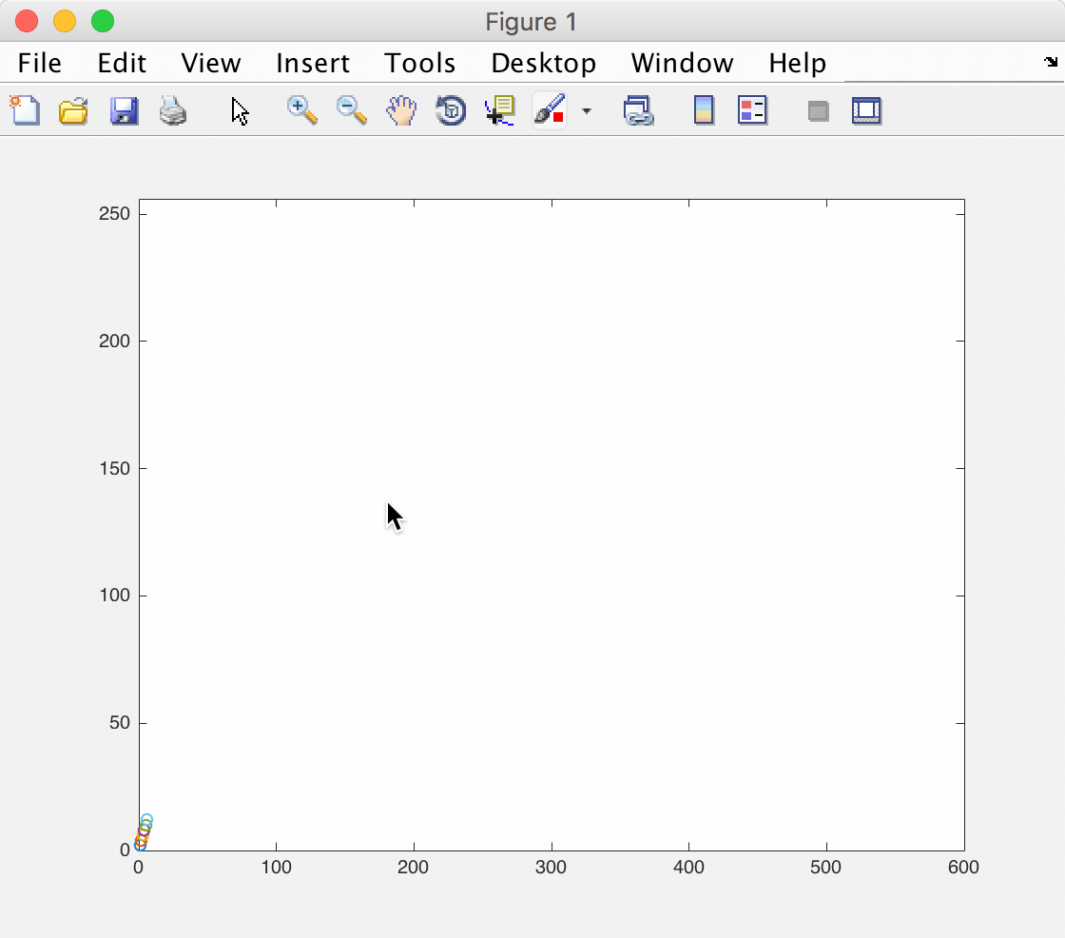
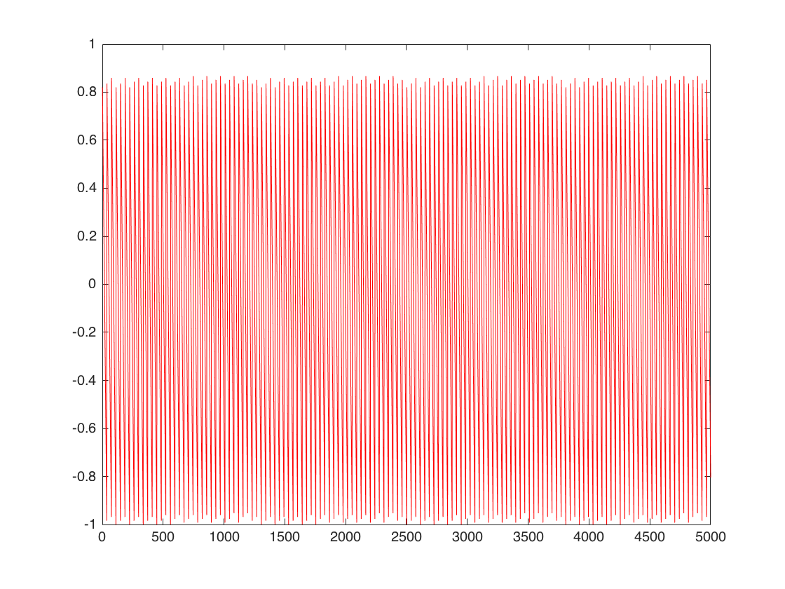
2
*
t
user_input
=
str_replace()
v
a
l
u
e
1
write
cal() % 256
2
4
6
8
10
12
14
16
…
index
data_array
index

Slide 7
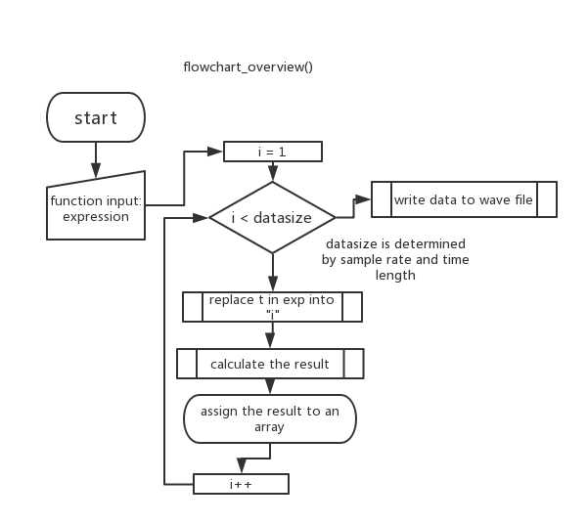
8 Bit Synth
3. writetofile()
思考
3. generate()
1. str_replace()
2. cal()

Slide 8
8 Bit Synth
思考
Implementation
main()
str_replace(presult, psource, “t”, “10”)
cal(): Expression Evaluation
generate(): Wave File Generate

Slide 9

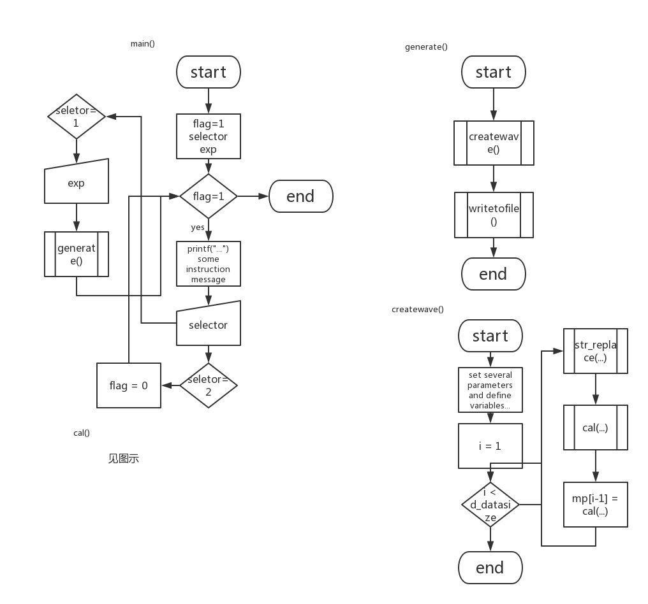
1. main()

Slide 10
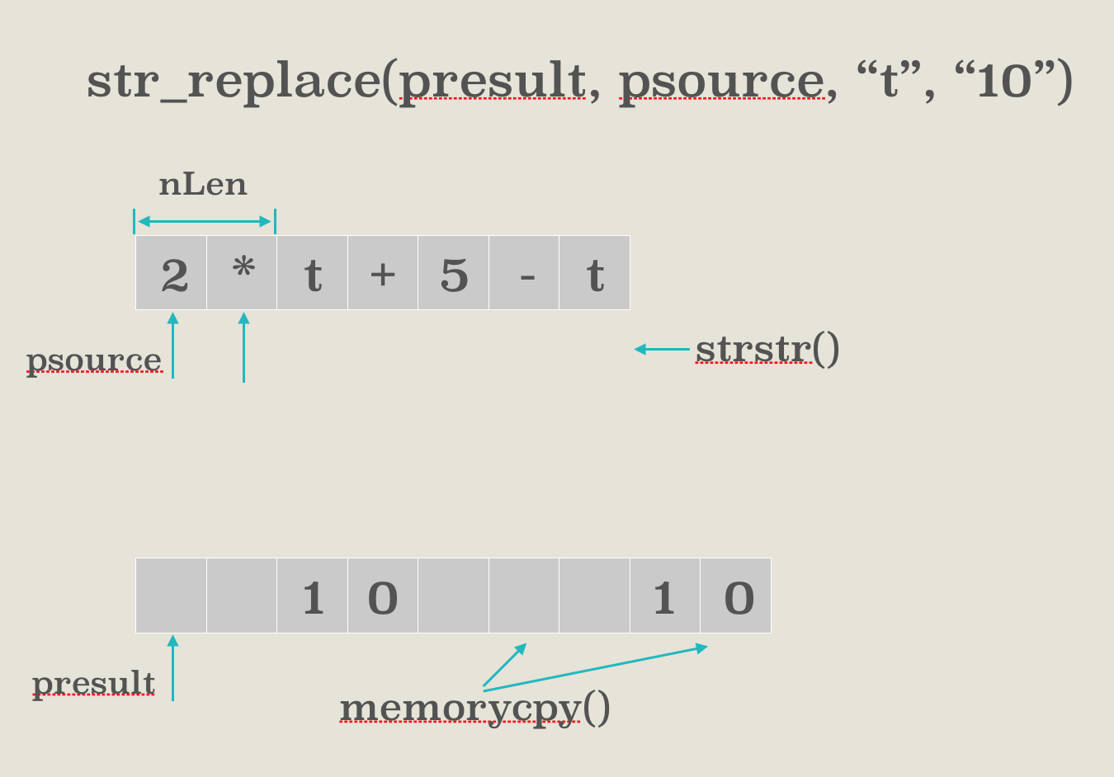
str_replace(presult, psource, “t”, “10”)
nLen
2
*
t
+
5
-
t
psource
strstr()
1
0
1
0
presult
memorycpy()

Slide 11
3. Expression Evaluation
8 Bit Synth
思考
9+(3-1)*3
9
3
1
-
3
*
+
)
3
1
-
9+(3-1)*3=15!
2
6
(
3
*
15
+
9

Slide 12
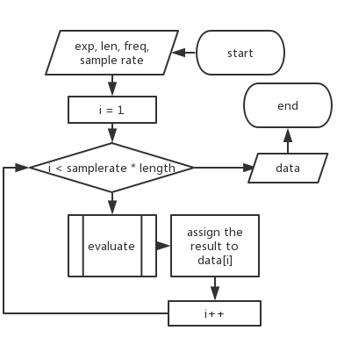
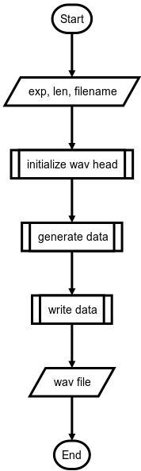
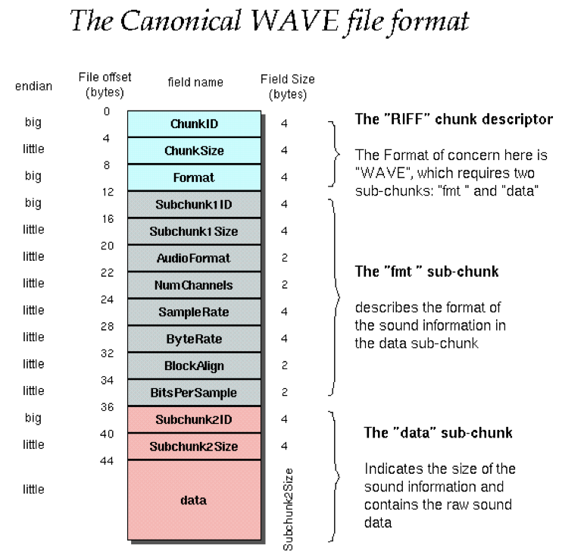
4. Wave File Generate
8 Bit Synth
思考
Generate File
Generate Data

Slide 13
Testing
8 Bit Synth
思考
Variable error
Operator error
Pairing error: 2+6*(8-7)*
NO SOUND warning
Test Input | Estimated Output | Output
2+x*x | There is no t in the expression | There is no t in the expression
34*t/23[34 | Please enter supported operator ('+', '-', '*', '/', '&', '|', '^', '<', '>', ‘%') Please enter valid expression | Please enter supported operator ('+', '-', '*', '/', '&', '|', '^', '<', '>', ‘%') Please enter valid expression
(t*5&t>06)|(t*3&t>07)|(t*4&t>05) | NO OUTPUT | NO OUTPUT
3 | Please enter correct number | Please enter correct number

Slide 14
Division
8 Bit Synth
Copy src to dest, return the dest address
Substitute every p_seach in p_source
Program integration
Lecture notes
思考
Xilai Fan
Ruoyao Shi
Turn data into array
Write data to .wav file
Create the .wav file and play it
PPT
Get num's value
Enumerate digits
Turn int into char
PPT
Qianhui Sun
Yang Pan
Calculate the priority of operator
Initialize, check and put data into stack
Pop elements
Lecture notes

Slide 15
Thank You
Q&A
Xilai Fan
Ruoyao Shi
Qianhui Sun
Yang Pan

Slide 16
8_bit synth
Group member:
Fan Xilai
Pan Yang
Sun Qianhui
Shi Ruoyao

Slide 17
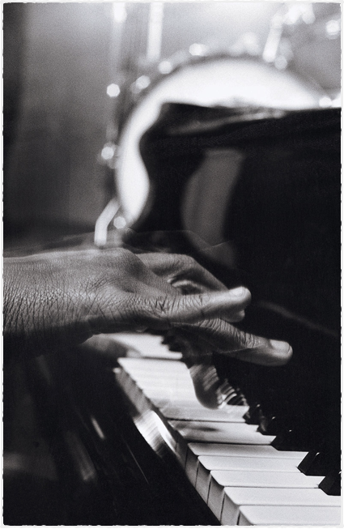
Analysis & Design
Divide this into 3 steps
Evaluate the expression
Generate .wav file
WAV file playback

Slide 18
Problem Statement
Use expression to generate sound

Slide 19
Group Division
范熙来 潘旸 孙芊荟 史若瑶

Slide 20
Analysis
&Design
2
*
t
user_input
=
str_replace()
v
a
l
u
e
1
write
cal() % 256
2
4
6
8
10
12
14
16
…
index
data_array
index

Slide 21
Expression Evaluation
8 Bit Synth
9+(3-1)*3
9
3
1
-
3
*
+
)
3
-
1
9+(3-1)*3=15!
2
6
(
3
*
15
+
9
Calculate

Slide 22
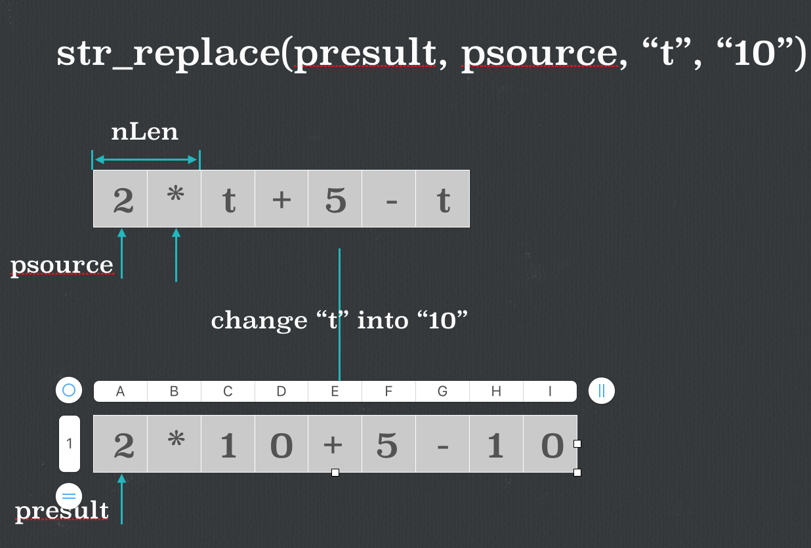
str_replace(presult, psource, “t”, “10”)
nLen
2
*
t
+
5
-
t
psource
strstr()
1
0
1
0
presult
memorycpy()

Slide 23
Expression Evaluation
9+(3-1)*3
9
3
1
-
3
*
+
)
3
1
-
9+(3-1)*3=15!
2
6
(
3
*
15
+
9
Calculate

Slide 24
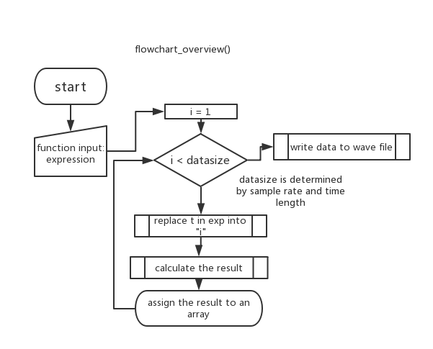

Slide 25
Implementation
Divide this into 3 steps
Evaluate the expression
Generate .wav file
WAV file playback

Slide 26
basic program frame
main()

Slide 27
str_replace(presult, psource, “t”, “10”)
nLen
2
*
t
+
5
-
t
psource
strstr()
1
0
1
0
presult
memorycpy()

Slide 28
Expression Evaluation
9+(3-1)*3
9
3
1
-
3
*
+
)
3
1
-
9+(3-1)*3=15!
2
6
(
3
*
15
+
9
Calculate

Slide 29
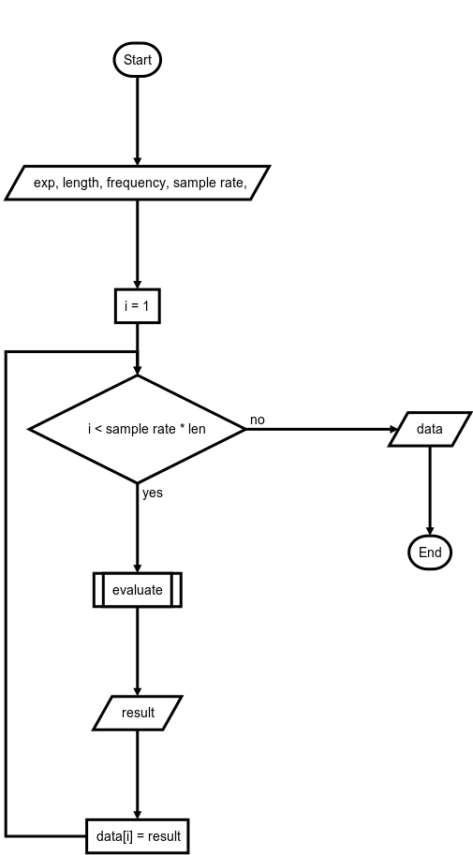
Generate .wav file
Generate File
Generate Data

Slide 30
Testing

Slide 31
Testing
Test Input | Estimated Output | Output
2+x*x | There is no t in the expression | There is no t in the expression
34*t/23[34 | Please enter supported operator ('+', '-', '*', '/', '&', '|', '^', '<', '>', ‘%') Please enter valid expression | Please enter supported operator ('+', '-', '*', '/', '&', '|', '^', '<', '>', ‘%') Please enter valid expression
(t*5&t>06)|(t*3&t>07)|(t*4&t>05) | NO OUTPUT | NO OUTPUT

Slide 32
Our Program
Present our program live

Slide 33


Slide 34
main(): basic program frame

Slide 35

Improvement
Local Preset Library
Real-Time Note Playing
Fancy UI

Slide 36
How This Work?

Slide 37
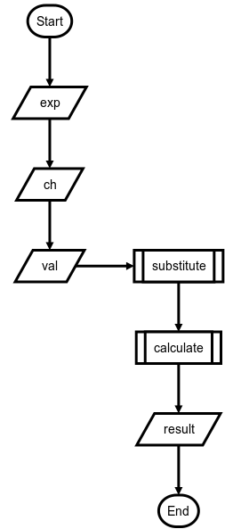
Evaluate the expression
Evaluate

Slide 38
WAV file playback
No solution now
We are now using system to call terminal script to play the file we generated

